Slide 1
File System Implementation and Allocation Methods

Slide 2
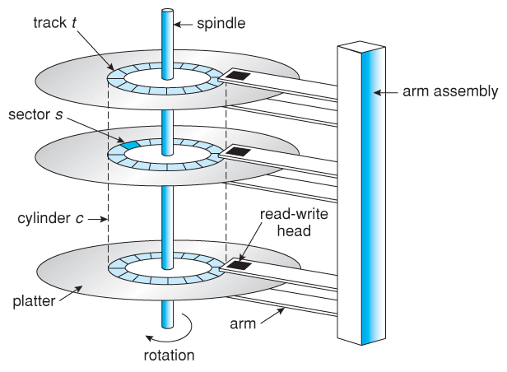
Disk Structure

Slide 3
File-System Structure
File structure
Logical storage unit
Collection of related information
File system resides on secondary storage (disks)
Provided user interface to storage, mapping logical to physical
Provides efficient and convenient access to disk by allowing data to be stored, located retrieved easily
Disk provides in-place rewrite and random access
I/O transfers performed in blocks of sectors (usually 512 bytes)
File control block – storage structure consisting of information about a file
Device driver controls the physical device
File system organized into layers

Slide 4
File System Layers
Device drivers manage I/O devices at the I/O control layer
Given commands like “read drive1, cylinder 72, track 2, sector 10, into memory location 1060” outputs low-level hardware specific commands to hardware controller
Basic file system given command like “retrieve block 123” translates to device driver
Also manages memory buffers and caches (allocation, freeing, replacement)
Buffers hold data in transit
Caches hold frequently used data
File organization module understands files, logical address, and physical blocks
Translates logical block # to physical block #
Manages free space, disk allocation

Slide 5
File System Layers (Cont.)
Logical file system manages metadata information
Translates file name into file number, file handle, location by maintaining file control blocks (inodes in Unix)
Directory management
Protection
Layering useful for reducing complexity and redundancy, but adds overhead and can decrease performance
Logical layers can be implemented by any coding method according to OS designer
Many file systems, sometimes many within an operating system
Each with its own format (CD-ROM is ISO 9660; Unix has UFS, FFS; Windows has FAT, FAT32, NTFS as well as floppy, CD, DVD Blu-ray, Linux has more than 40 types, with extended file system ext2 and ext3 leading; plus distributed file systems, etc)
New ones still arriving – ZFS, GoogleFS, Oracle ASM, FUSE

Slide 6
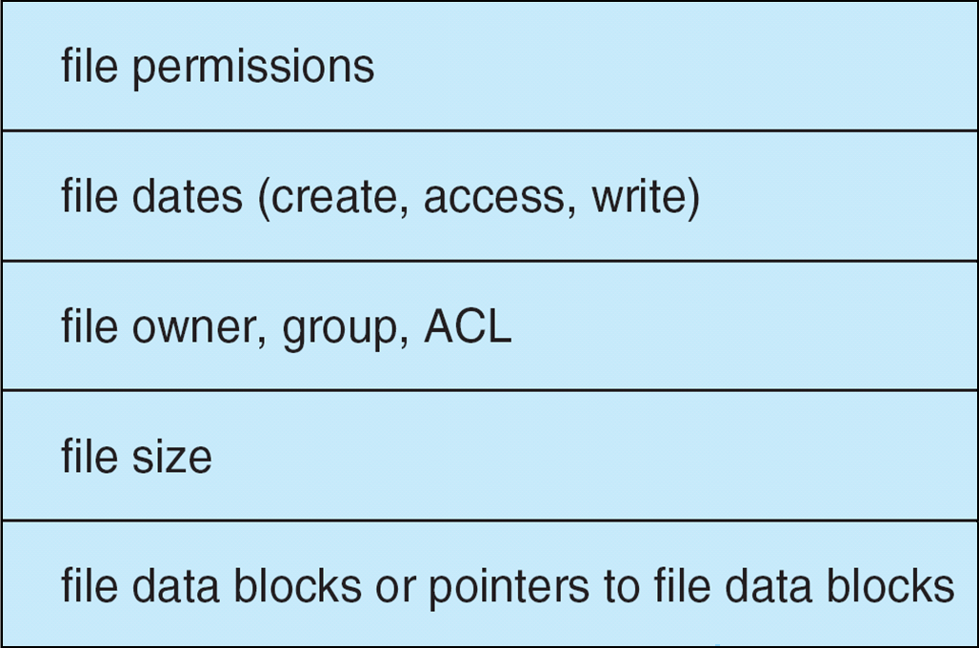
A Typical File Control Block

Slide 7
Directory Implementation
Linear list of file names with pointer to the data blocks
Simple to program
Time-consuming to execute
Linear search time
Could keep ordered alphabetically via linked list or use B+ tree
Hash Table – linear list with hash data structure
Decreases directory search time
Collisions – situations where two file names hash to the same location
Only good if entries are fixed size, or use chained-overflow method

Slide 8
Allocation Methods - Contiguous
An allocation method refers to how disk blocks are allocated for files:
Contiguous allocation – each file occupies set of contiguous blocks
Best performance in most cases
Simple – only starting location (block #) and length (number of blocks) are required
Problems include finding space for file, knowing file size, external fragmentation, need for compaction off-line (downtime) or on-line

Slide 9
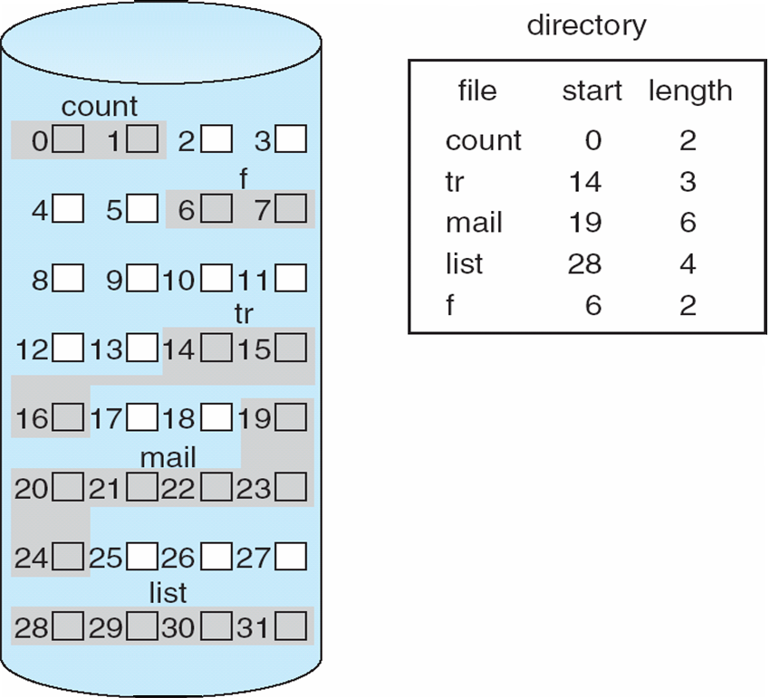
Contiguous Allocation of Disk Space

Slide 10
Allocation Methods - Linked
Linked allocation – each file a linked list of blocks
File ends at nil pointer
No external fragmentation
Each block contains pointer to next block
No compaction, external fragmentation
Free space management system called when new block needed
Improve efficiency by clustering blocks into groups but increases internal fragmentation
Reliability can be a problem
Locating a block can take many I/Os and disk seeks
FAT (File Allocation Table) variation
Beginning of volume has table, indexed by block number
Much like a linked list, but faster on disk and cacheable
New block allocation simple

Slide 11
Linked Allocation
Each file is a linked list of disk blocks: blocks may be scattered anywhere on the disk
block =
pointer

Slide 12
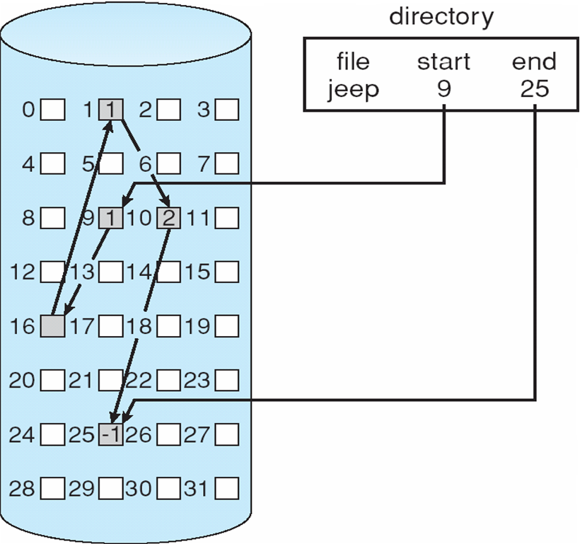
Linked Allocation

Slide 13
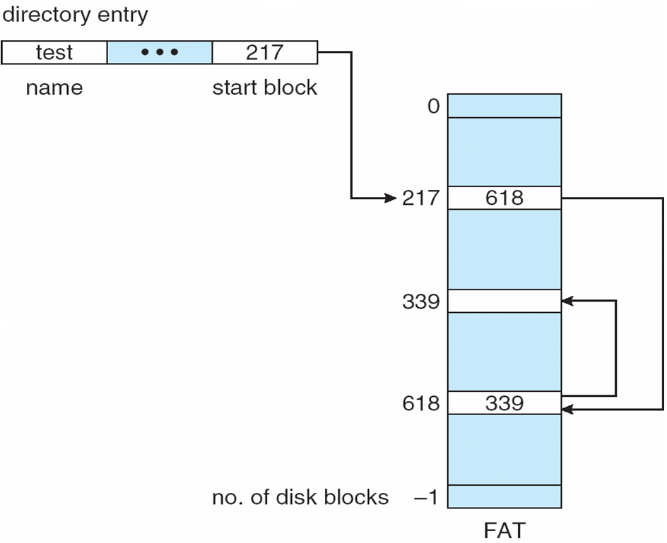
File-Allocation Table

Slide 14
Allocation Methods - Indexed
Indexed allocation
Each file has its own index block(s) of pointers to its data blocks
Logical view
index table

Slide 15
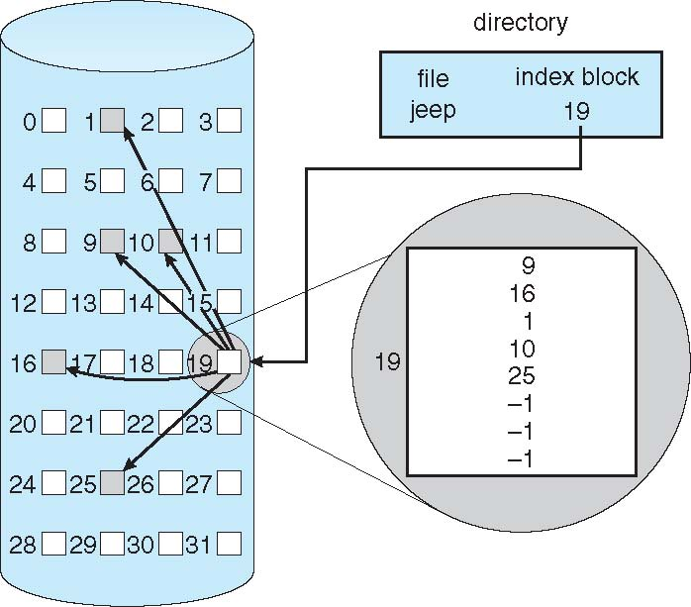
Example of Indexed Allocation

Slide 16
Indexed Allocation – Mapping (Cont.)

outer-index
index table
file

Slide 17
Thank You

